Slide 1
Agenda
HTML
CSS
Best Practices
Assessment Tasks based on HTML & CSS

Slide 2
Hyper Text Markup Language

Slide 3
Hyper Text Markup Language-Features
Web page is a web document that is suitable for the World Wide Web and the web browser​
HTML(Hyper Text Markup Language) is the standard markup language used to create web pages​
​HTML is written in the form of HTML elements consisting of tags enclosed in angle brackets(like <html>).
HTML describes the structure of a website semantically along with cues for presentation, making it a markup language rather than a programming language

Slide 4
Main Points
Markup language not equal programming language​
Hypertext is text displayed on a computer display or other electronic devices with references
HTML is the standard markup language for creating Web pages
HTML describes the structure of a Web page
HTML consists of a series of elements
HTML elements tell the browser how to display the content

Slide 5
Web Page Structure
<html>
This is a container that includes the entire page content.
There is always two sections on the page: head and body.
<head>
Contains information about the HTML file:
The name of the page, style, metatags and additional information.
<meta>
Meta tags that contain information for browsing and retrieval systems(charset,description,keywords) for SEO, OpenGraph, etc.
<body>
Contains all the text and tags that are displayed on the page.

Slide 6
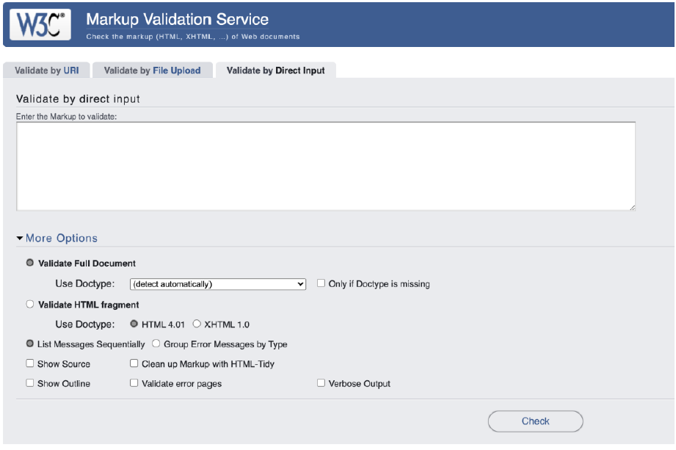
Validation
Validator checks the markup validity of Web documents in HTMLvalidator.w3.org

Slide 7
Elements of the Page
Headings:
<h1>,<h2>,<h3>,<h4>,<h5>,<h6>
•Some block elements:
<p>,<pre>,<address>,<blockquote>
•Some inline elements:
<sub>,<sup>,<del>,<ins>,<code>,<q>,<cite>,
<big>,<small>,<b>,<strong>,<i>,<em>,<br>,<hr>

Slide 8

Block and Inline Elements
A block-level element always starts on a new line.
A block-level element always takes up the full width available (stretches out to the left and right as far as it can).
A block level element has a top and a bottom margin, whereas an inline element does not.
An inline element does not start on a new line.
An inline element only takes up as much width as necessary.

Slide 9
CSS

Slide 10
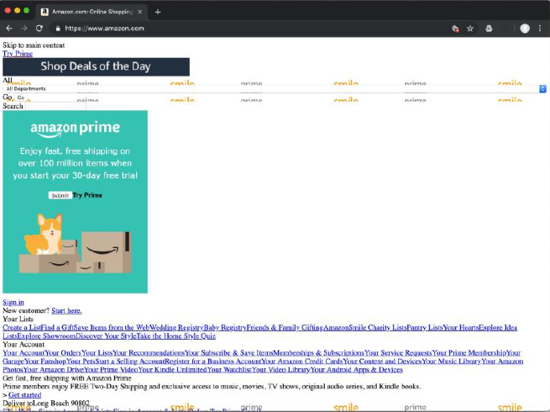

Why CSS ?

Slide 11
CSS Definitions
Cascading Style Sheets (CSS) are a stylesheet language used to describe the presentation of a document written in HTML or XML (including XML dialects like SVG or XHTML).
CSS describes how elements should be displayed on screen, on paper, in speech, or on other media. CSS is the only document styling language that browsers understand.​
CSS has a standardized W3C specification.​
CSS1 is now obsolete,​
CSS2.1 is a recommendation,​
CSS3 is split into smaller modules, progressing on the standardization track.​

Slide 12
The Basic Syntax of CSS
p{​
color : red;​
}​
selector
declaration
p
{ color : red ; }
property
value

Slide 13
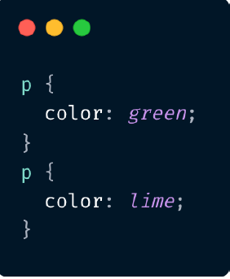
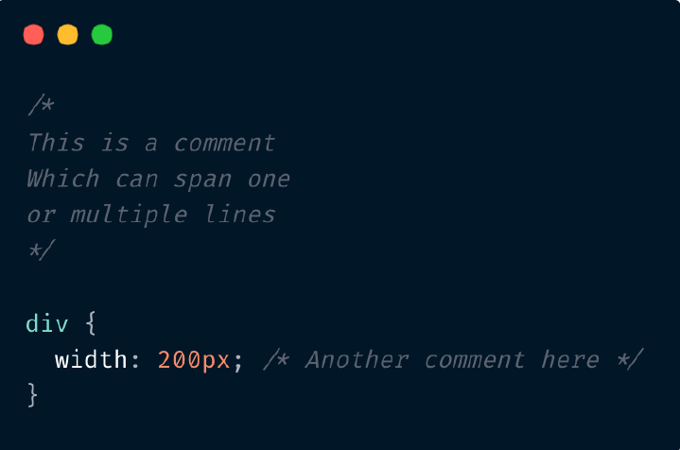
The basic syntax of CSS
ORDER MATTERS COMMENTS IN CSS
P color will be lime

Slide 14
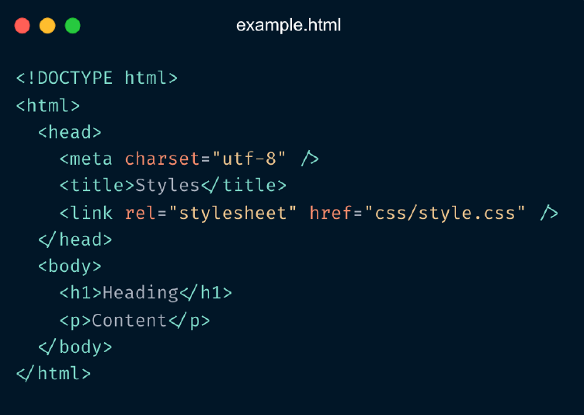
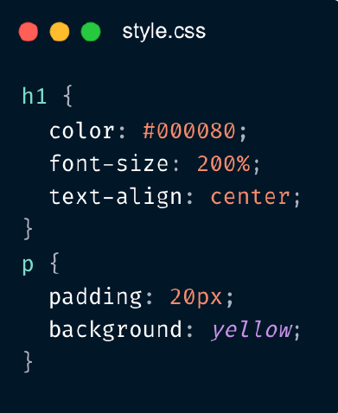
Adding styles to the page -external styles

Slide 15
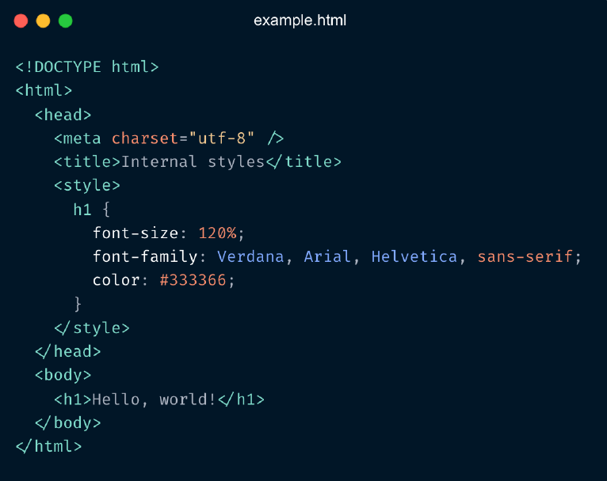
Adding styles to the page -internal styles

Slide 16
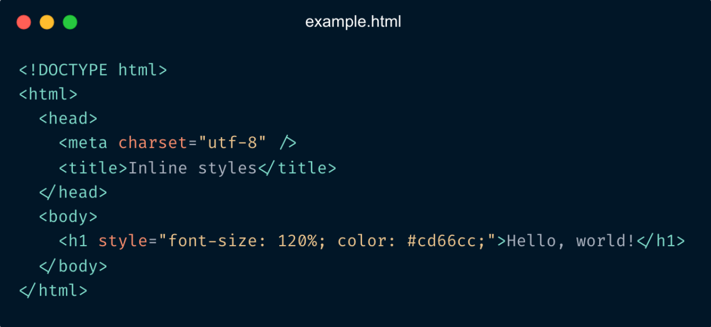
Adding styles to the page -inline styles

Slide 17
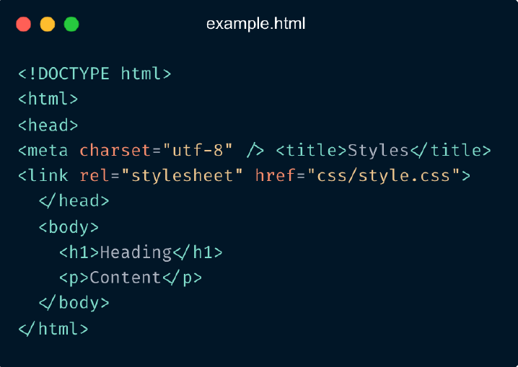
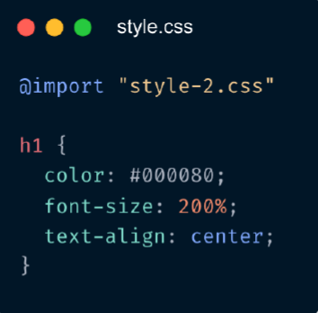
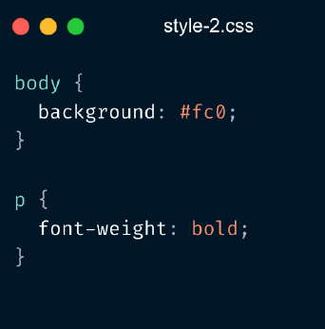
Importing Styles

Slide 18
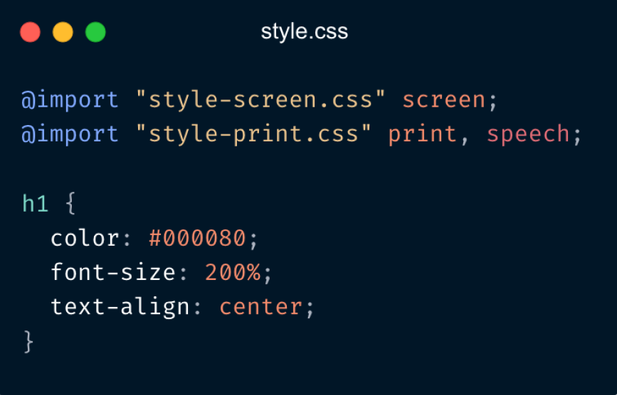
Specify media type: @import

Slide 19
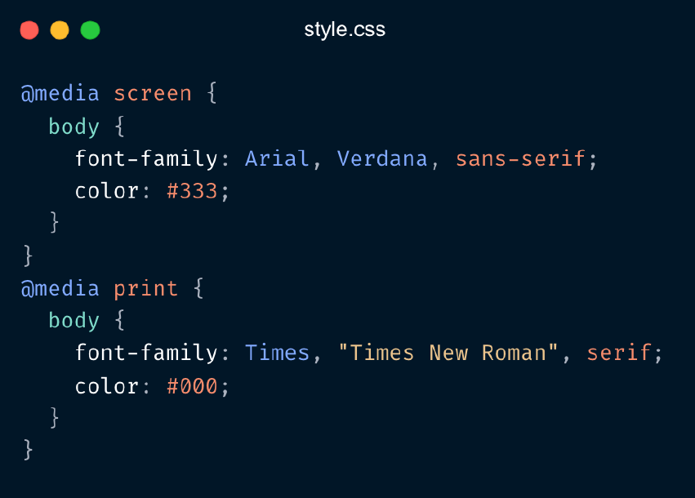
Media type using media queries

Slide 20
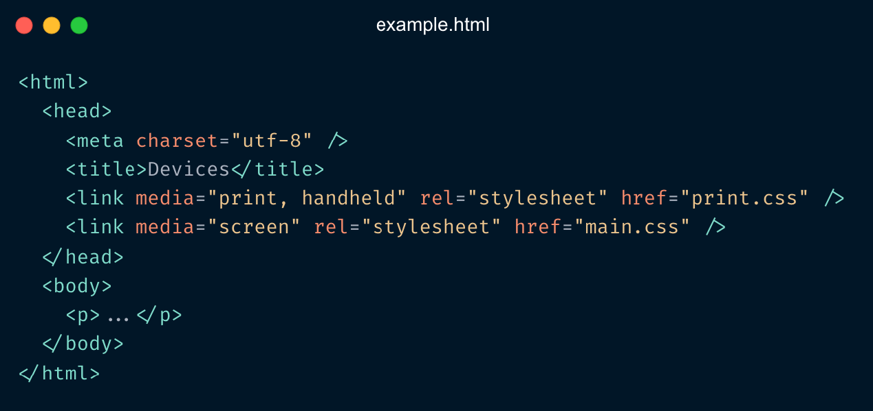
Media type in HTML “media” attribute

Slide 21
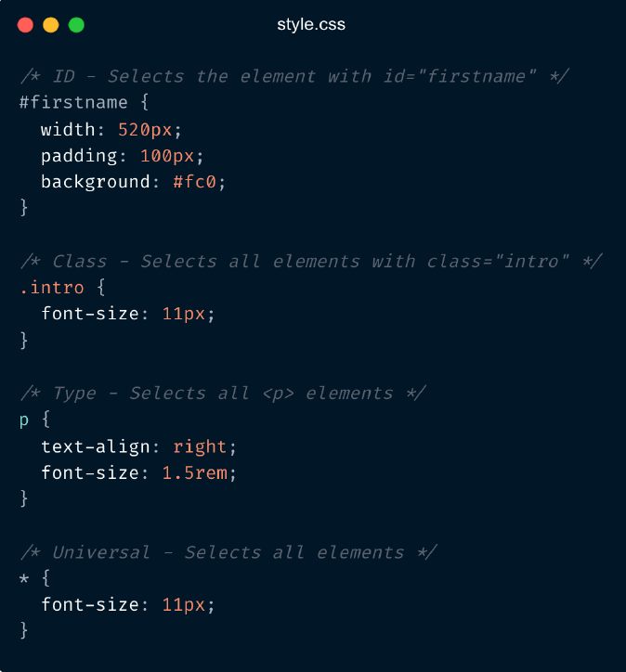
Basic Selectors
ID
Selects the element with id="firstname"
Class
Selects all elements with class="intro"
Type
Selects all <p> elements
Universal
Selects all elements

Slide 22
Combinators
Groups of selectors
A comma-separated list of selectors represents the union of all elements selected by each of the individual selectors in the list
Descendant combinator
Selects all <p> elements inside <div> elements
Child combinator
Selects all <p> elements where the parent is a <div> element
Adjacent sibling combinator
Selects all <p> elements that are placed immediately after <div> elements
General sibling combinator
Selects every <ul> element that are preceded by a <p> element
div , p
div p
div > p
div > p
div + p
div + p
p ~ ul

Slide 23
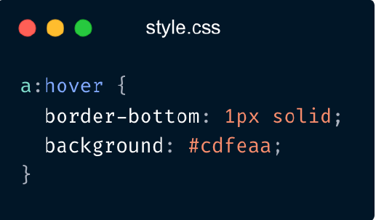
Pseudo-classes
The pseudo-class concept is introduced to
permit selection based on information that lies
outside of the document tree or that cannot be
expressed using the other simple selectors.

Slide 24
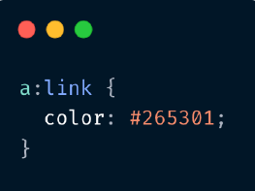
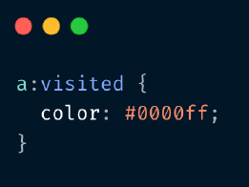
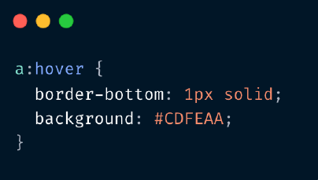
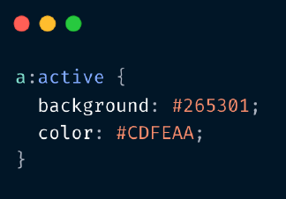
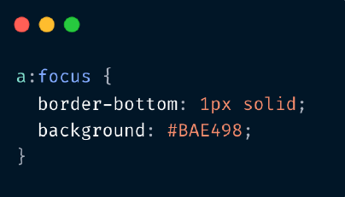
Dynamic Pseudo-classes
Link
User Action

Slide 25
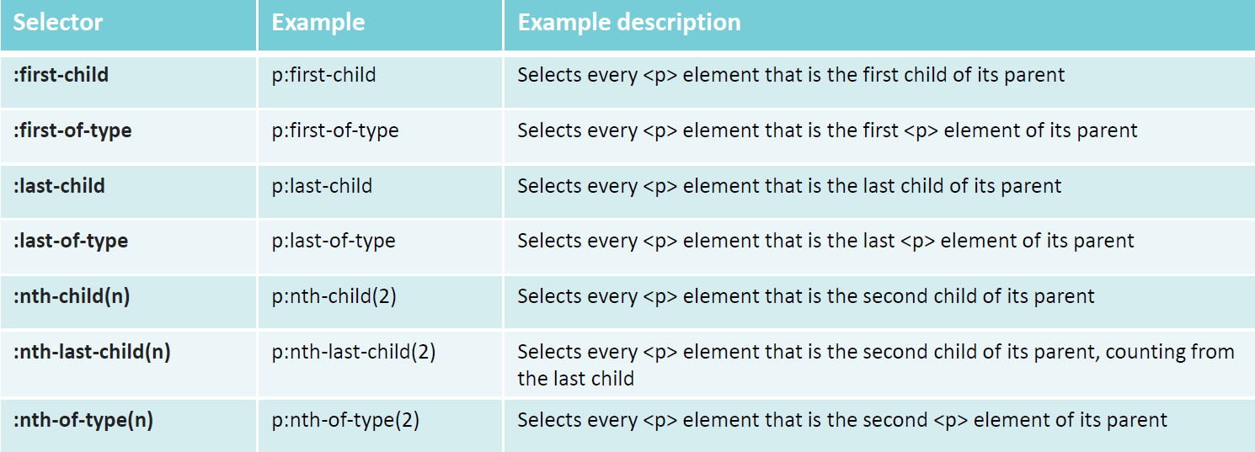
(Some) structural pseudo-classes

Slide 26
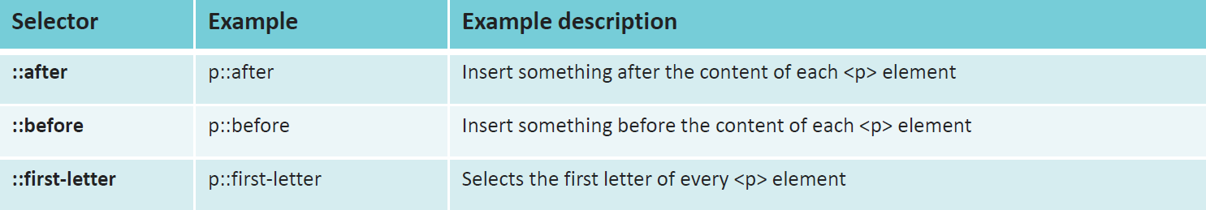
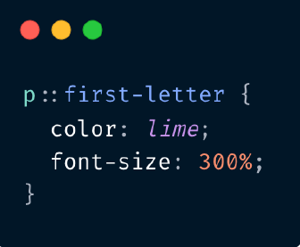
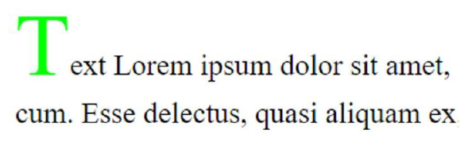
Pseudo-elements

Slide 27
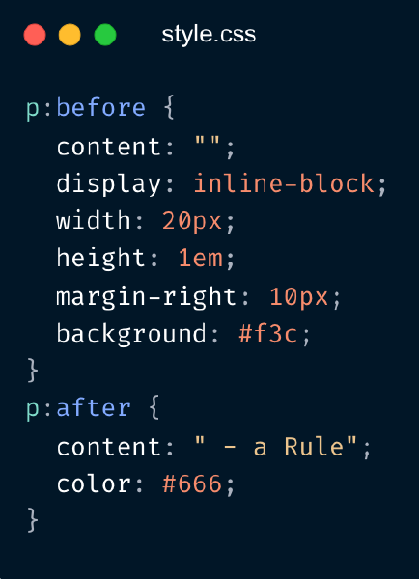
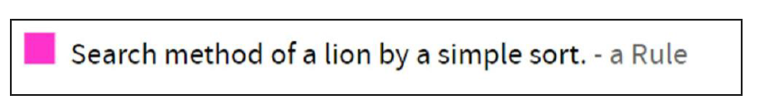
Pseudo-elements

Slide 28
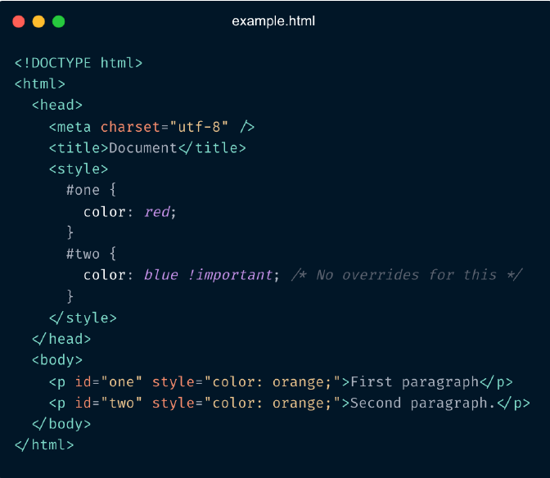
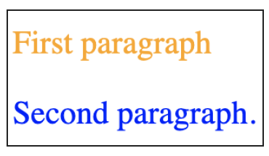
!important
!important declaration overrides any other CSS
declaration.
selector {
property: property value !important;
}

Slide 29
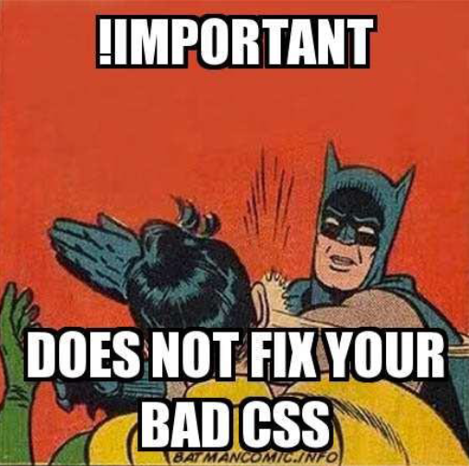
!important usage
You can use !important (it is not an anti-pattern), when
your goal is that the property should not be overridden.
Never use !important to override other rules!
Do use selectors with proper specificity to achieve that.

Slide 30
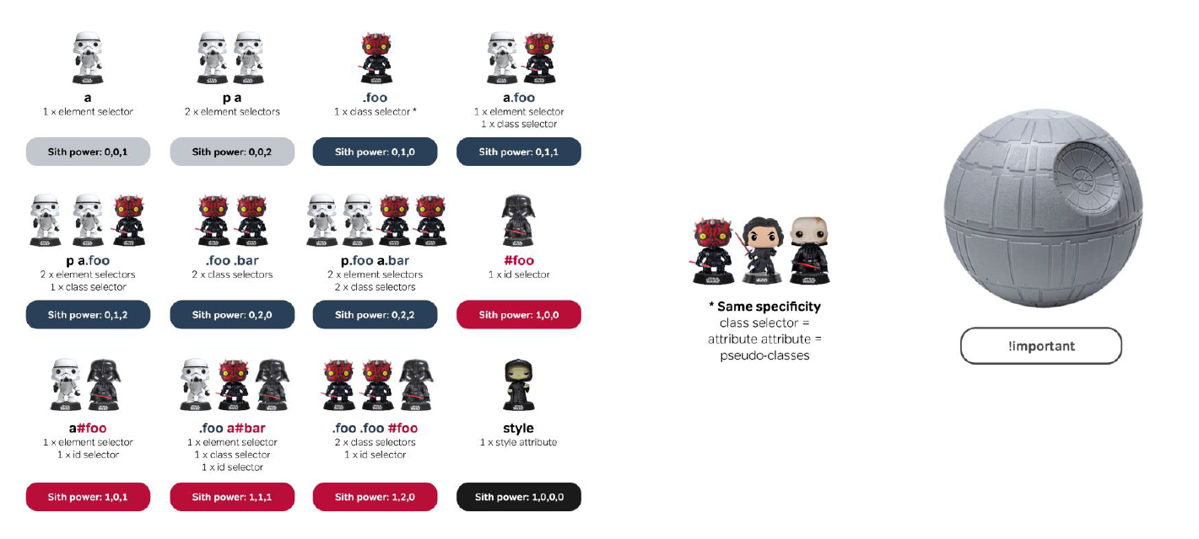
CSS Specificity

Slide 31
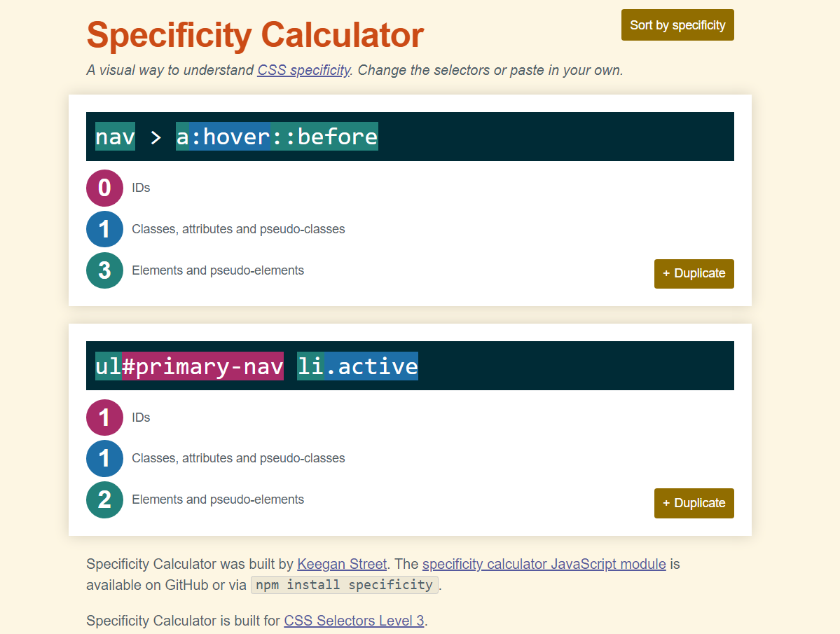
Specificity Calculator
Specificity Calculator : https://specificity.keegan.st/

Slide 32

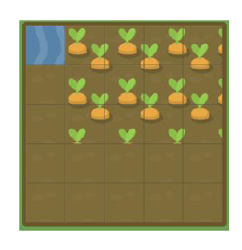
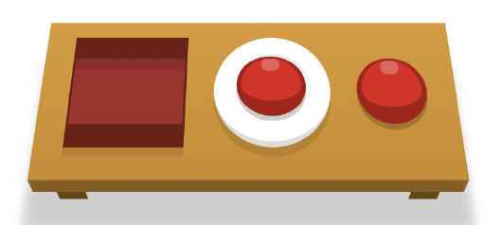
Games- Practising….
https://flukeout.github.io/ - ...selectors
https://flexboxfroggy.com/ - ...flexbox
https://cssgridgarden.com/ - ...css grid

